Slide 1

https://www.uni-goettingen.de/en/48115.html
Unless I explicitly state otherwise, images and cartoons are created using ChatGPT.
You may use this material free of charge under the terms of the CC BY license. This requires that you provide appropriate attribution to the author: W. Link, University of Goettingen, Germany.
In a few cases, individual images, photographs, or similar material may be subject to a more restrictive Creative Commons license. Where this applies, it is explicitly indicated, and you must comply with the stated license terms for those items.
Please check the license information carefully before reuse. Responsibility for complying with the applicable license terms rests entirely with you. The copyright for images of books or logos and the like may belong to the author or publisher or company, so please take strict note of this when handling them.
1
A very general and personal motivation for Plant Breeding as Profession, as field of Research, as part of Agronomy and Agriculture. © Wolfgang Link 2026 wlink@gwdg.de

Slide 2
Sequential Number: #1
UNPLAB-INTRO_Ch-1
I am Wolfgang Link. From 1995 on for several decades I taught Plant Breeding at Georg-August University Göttingen, Germany (ww.uni-goettingen.de/de/48115.html). UNPLAB means ‘Understand Plant Breeding’. If you find mistakes (you will, although I try hard to avoid them), please tell me so. I you find this œvre useful, tell others to use it as well. I personally am completely in favour of this material being free for use in whatever way, but everyone must know for themselves how to deal with copyright and the like. I have tried hard to quote everything correctly, but of course a 100% guarantee is literally impossible. I have no financial intentions or dependencies or anything like that, I was and am completely free in what I write. Anyone who is toying with the idea of harming me with or because of this work should put these thoughts away. I am not prepared for trouble in my advanced age. If someone unexpectedly tries it, well, you'll find out that it doesn't make you happy.
I have gladly and with commitment put the sum and essence of my teaching into this form; to make the field of Plant Breeding accessible to learners and experts – yet in my own way. I hope it helps; one or the other.
2

Slide 3
Keywords of this chapter
The cosmos, the planet, us humans.
Over-population of the planet.
Feed one person from the productivity of 2000m² land
Plant Breeding is … what?
Is Plant Breeding the most powerful tool to ‚save the world‘?
Some data on what plant breeding may be able to do.
Superstition etc. as part of the plant breeding community
Farmers‘ rights (to use the seed they harvested from growing a released cultivar and sow it again for a next season)
Breeders‘ rights (to use any released cultivar for own breeding work)
Important Algebra of this chapter: none.
This is the first chapter of a series of chapters, including 11 ones on Population Genetic, followed chapters on GxE (including the Breeder’s Equation) and Plant Breeding Methods (6 and 13); then three on Correlated Traits. Quantitative Genetics follows with 14 Chapters. Maybe I will add some “Miscellaneous” – we shall see (31 12 2025).
3

Slide 4
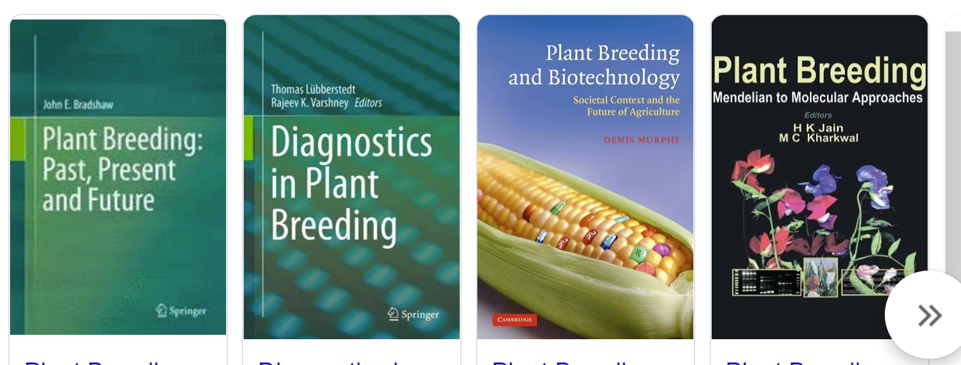
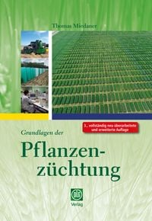
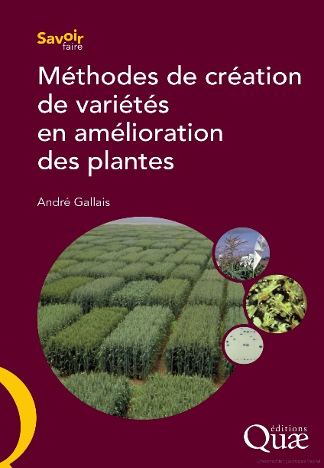

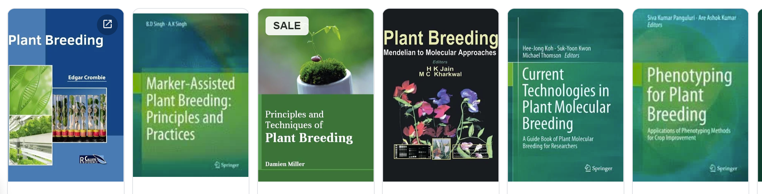
Plant Breeding as Profession, as field of Research, part of Agronomy and Agriculture. © Wolfgang Link wlink@gwdg.de
The copyright for images of books or logos and the like always belongs to the author or publisher or company, so please take strict note of this when handling them.
4

Slide 5

The ‘Pale Blue Dot’ is an overly famous, mind-stirring photograph of planet Earth taken Feb. 14, 1990, by NASA's Voyager 1 space probe, looking ‘back to us’ from a distance of 6 ∙ 10⁹ km (farther than Neptune; meanwhile Voyager 1 flies at 24 ∙ 10⁹ km).
Carl Sagan:
Look again at that dot. That's here. That's home. That's us. On it everyone you love, everyone you know, everyone you ever heard of, every human being who ever was, lived out their lives. The aggregate of our joy and suffering, thousands of confi-dent religions, ideologies, and economic doctrines, every hunter and forager, every hero and coward, every creator and de-stroyer of civilization, every king and pea-sant, every young couple in love, every mother and father, hopeful child, inventor and explorer, every teacher of morals, every corrupt politician, every "superstar," every "supreme leader," every saint and sinner in the history of our species lived there - on a mote of dust suspended in a sunbeam.
Courtesy NASA/JPL-Caltech; www.jpl.nasa.gov/jpl-image-use-policy
5

Slide 6


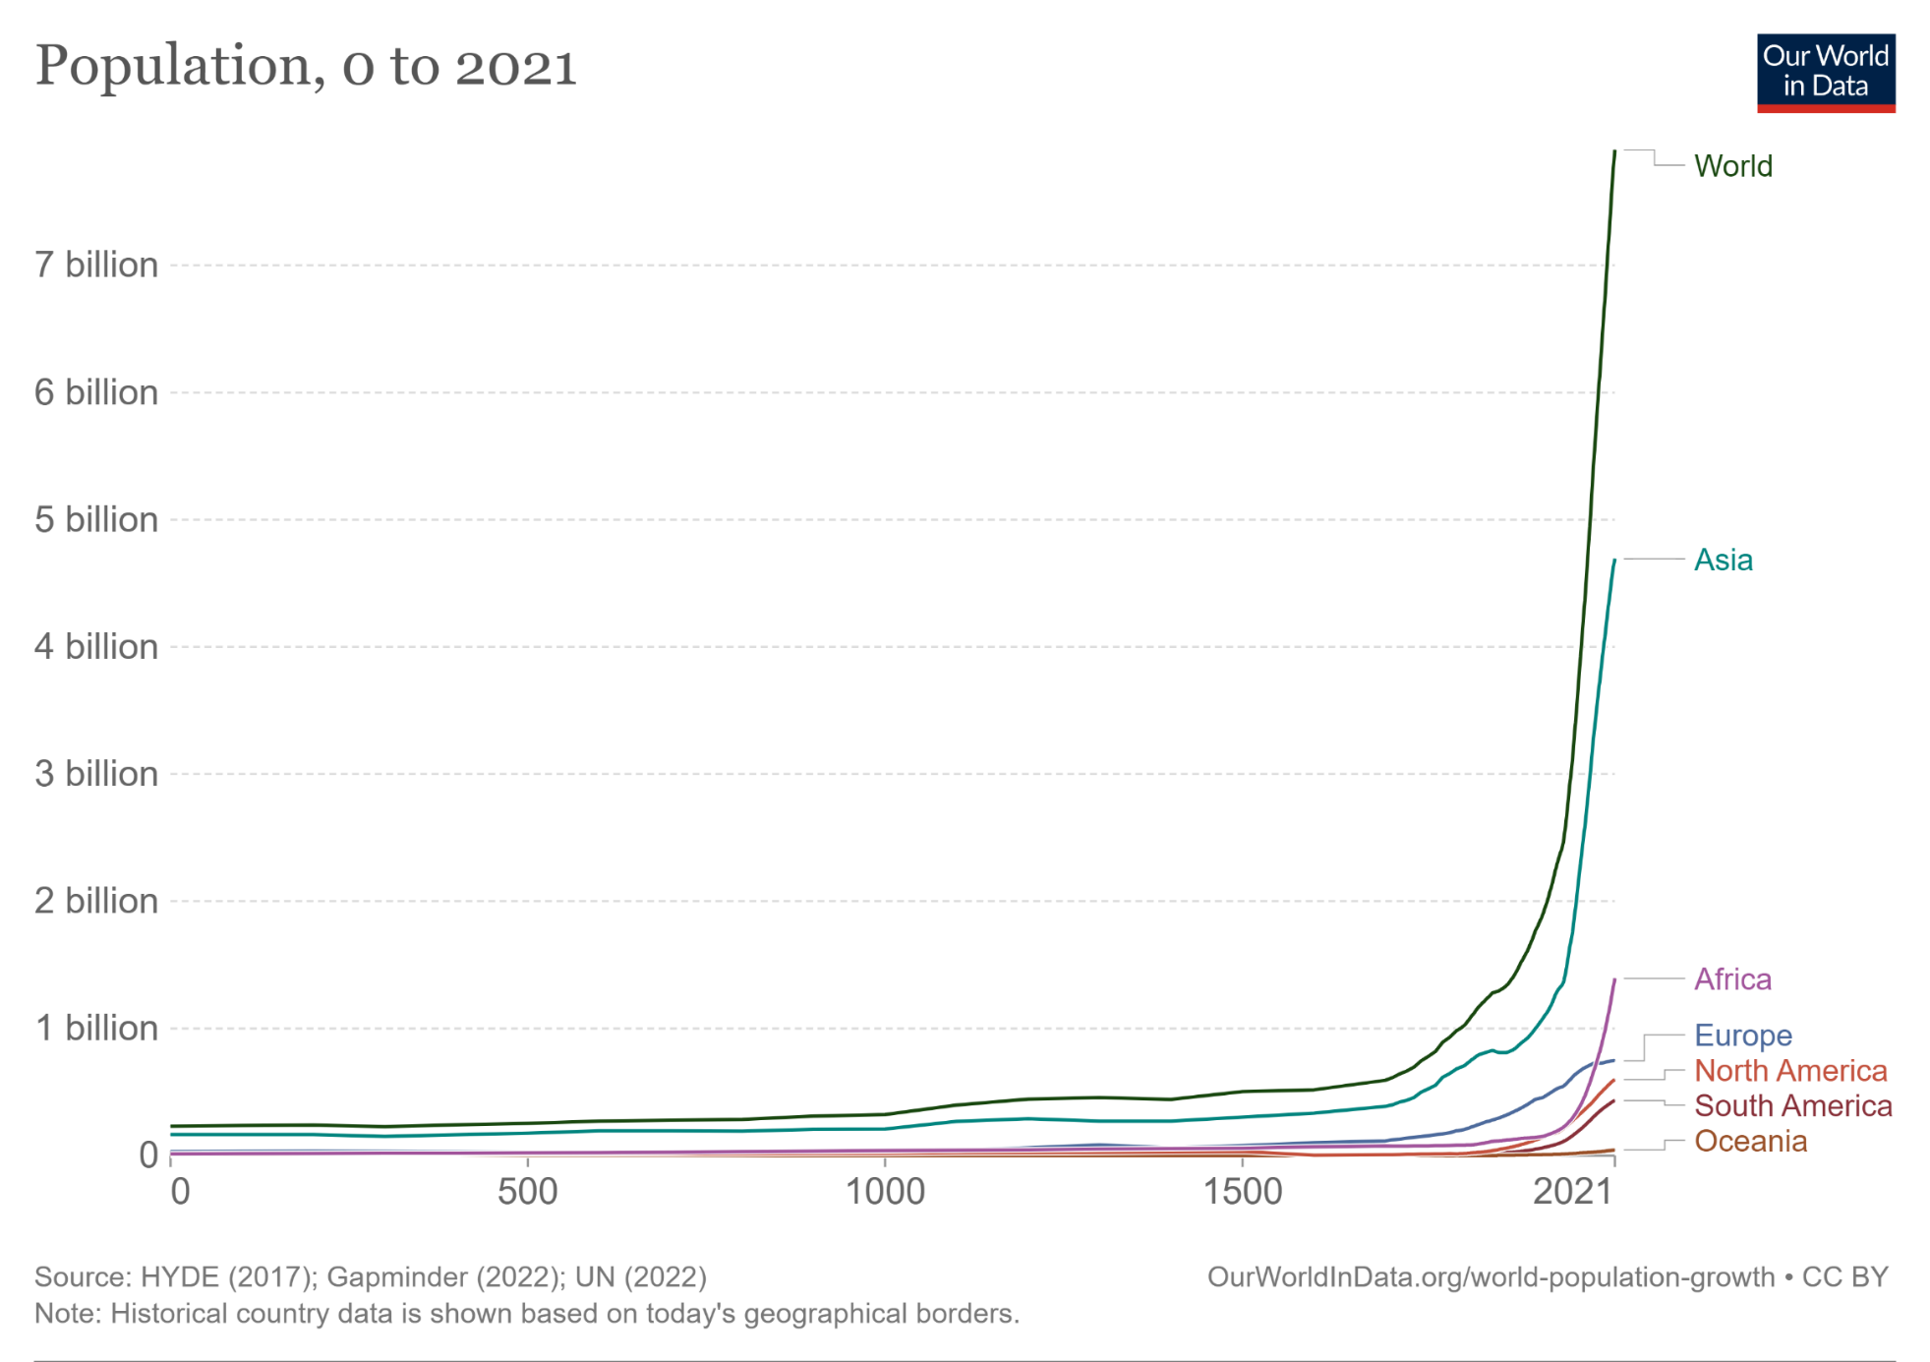
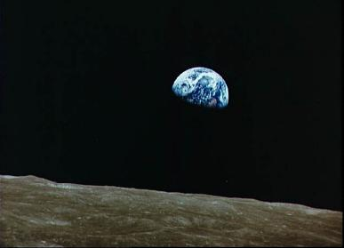
The number of humans on our planet is fast growing. Probably our top problem!
Although we consider every single human life to be infinitely valu-able, the very large number of us, us people now living at the same time, is a problem of utmost im-portance. Most of all our calami-ties and problems would be much less if we were significantly fewer people on this planet.
Increase of global population from year 0 to 2021
7.000.000.000
> 8 ∙ 10⁹ humans on planet Earth
13.06.2023 13:38:28
N = 8,038,514,998
13.06.2023 14:38:28
N = 8,038,523,998
Increase of N = 9.000 in 1 hour
NASA, public domain, free picture. www.jpl.nasa.gov/jpl-image-use-policy
HYCE 2017; Gapminder 2022; UN 2022.
https://ourworldindata.org
6

Slide 7
The number of humans was and is fast growing. Probably our top problem!
We need water, food, energy, shelter, infrastructure, education, culture, and more.
We build and consume; we throw away, pollute, ruin, destroy, forget, overlook, err.
Here, in this chapter, my focus is on Agricultural food production and Plant Breeding as part of it.
Increase of global population from year 0 to 2021
7.000.000.000
NASA, public domain, free picture
HYCE 2017; Gapminder 2022; UN 2022.
https://ourworldindata.org
7

Slide 8
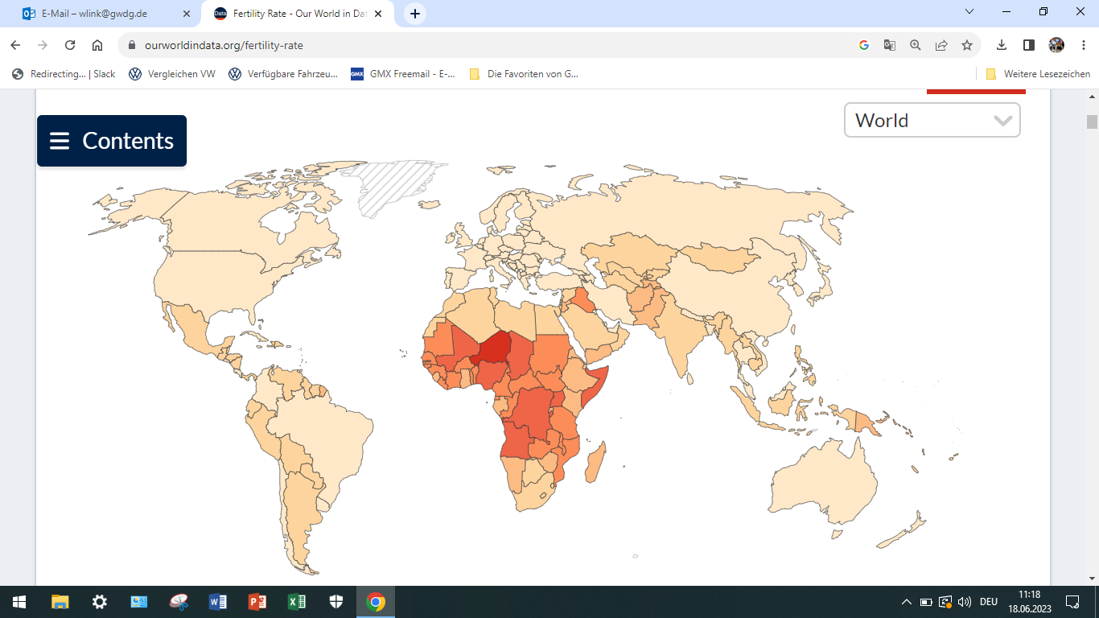
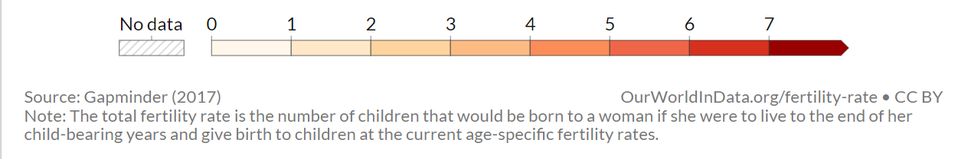
Our fertility rate in 2021: Number of children per woman.
Africa contributes most (per woman) to the current increase of the human population.
Very high fertility in Niger (6.9), compared to very low fertility in Portugal (1.3).
8
https://ourworldindata.org
https://ourworldindata.org/fertility-rate

Slide 9
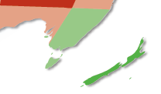
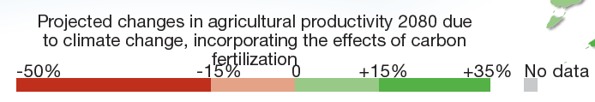
Changes in agricultural output due to climate change until 2080 (todays new-borns not yet in pension by then).
The map visualizes roughly expected changes in agricultural yields. Changes due to Climate Change, i.e. due to higher temperatures, changed rain patterns and amount, increased CO₂ content of the air (‘carbon fertilization’).
Predictions are complicated because agriculture will respond with e.g. adapted rotations, crops, and cultivars. Anyway, consequences of extreme weather events involving storms, hail, erosion, heat waves and desertification are difficult to assess.
Global climate change will impact agronomy output in different regions differently. Today, seen globally, food and feed should be enough for all of us. But globally balancing surplus and need does not work. We are facing increasing problems.
Even if projections will not prove exact.
https://reliefweb.int/organization/unep
9

Slide 10
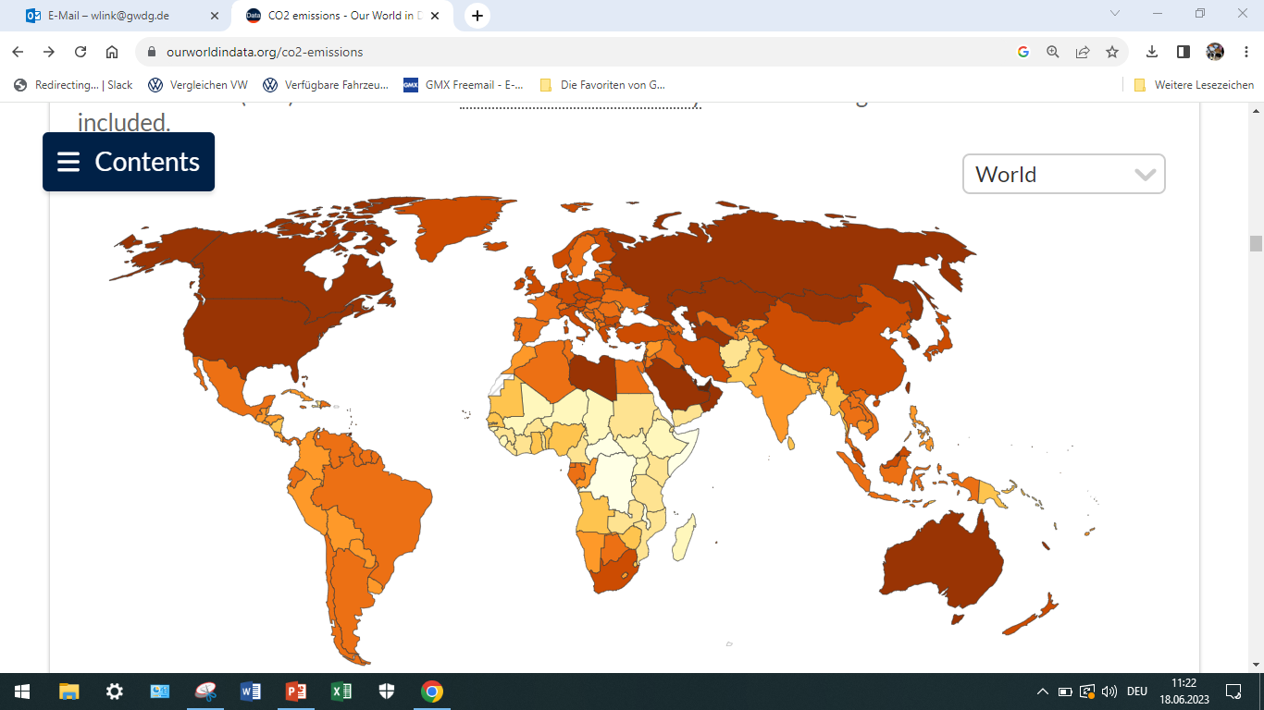
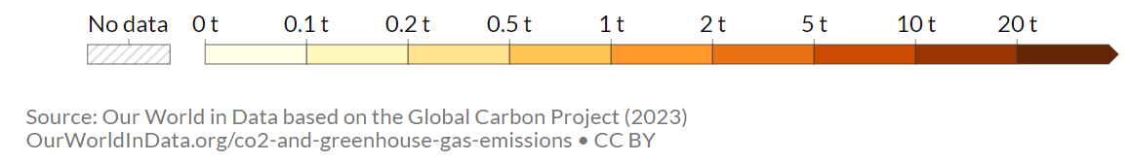
CO₂ emission in 2021 per person.
CO₂ emitted from coal, oil, gas, flaring, cement, steel, and from further industry processes.
Not included: Deforestation and emissions from soils and water.
Global emissions were 2 ∙ 10⁹ t in 1900, 20 ∙ 10⁹ t in 1985, and 37 ∙ 10⁹ t in 2021. Peak not yet reached.
Have a look at Kuwait and the Arabic Emirates
https://ourworldindata.org
https://ourworldindata.org/per capita Co2 emissions
10

Slide 11
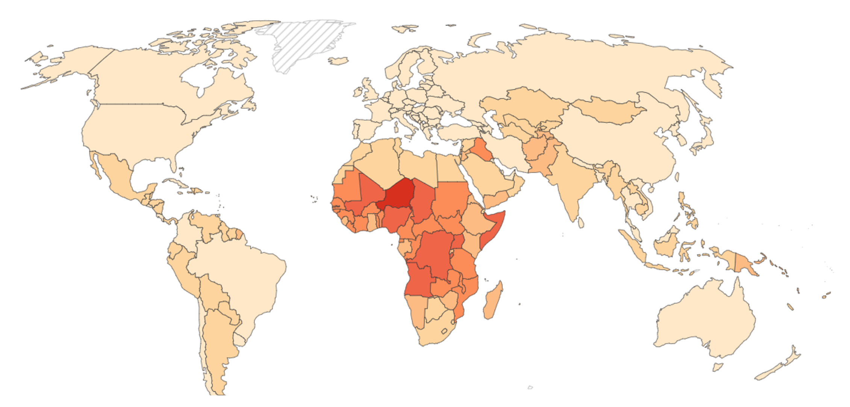
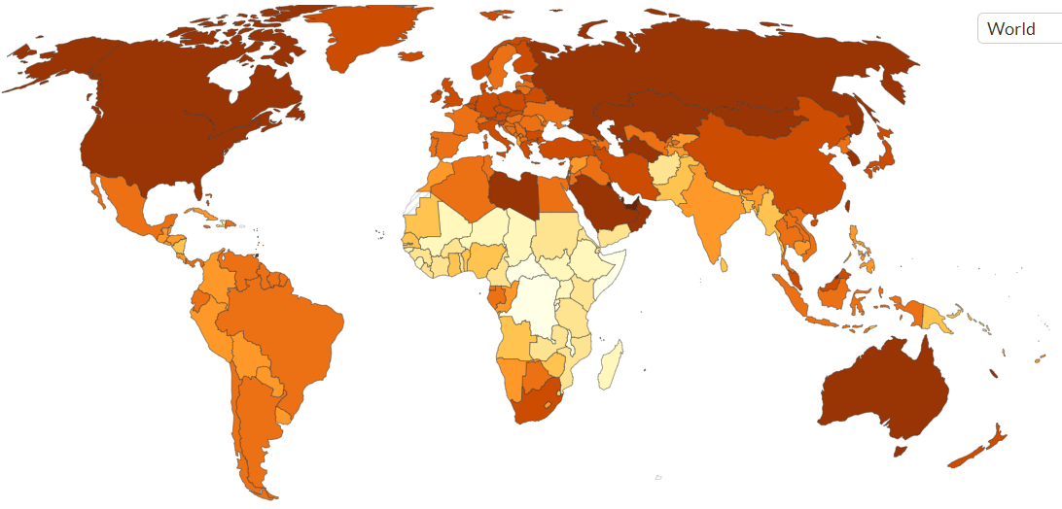
Fertility rate per woman (top) and CO₂ emission per person (below), in 2021.
Even if e.g. Niger reduced its fertility, this would probably not cause a reduced CO₂ emission of Germany or Bahrain. Even if Germans consumed much less car-fuel than today, this by itself would not cause population growth in Africa to lessen.
Yet. Let us be cautious.
Such statement seems be reasonable and accurate and it seems to de-couple the two trends and to release North and South from mutual responsibility for each other. But this may just be populism, fake-news, wishful thinking, not helpful.
It might nevertheless be true that corruption et cetera in fuel-selling countries of the South lower the cost of fuel for the North and thus increases burning of oil in the North.
It might be true that greed and power-policy of the North slows-down the development of the South so that there old-age pension and health insurance systems do not work and thus children seem to be necessary for the survival of senior persons.
https://ourworldindata.org
11

Slide 12
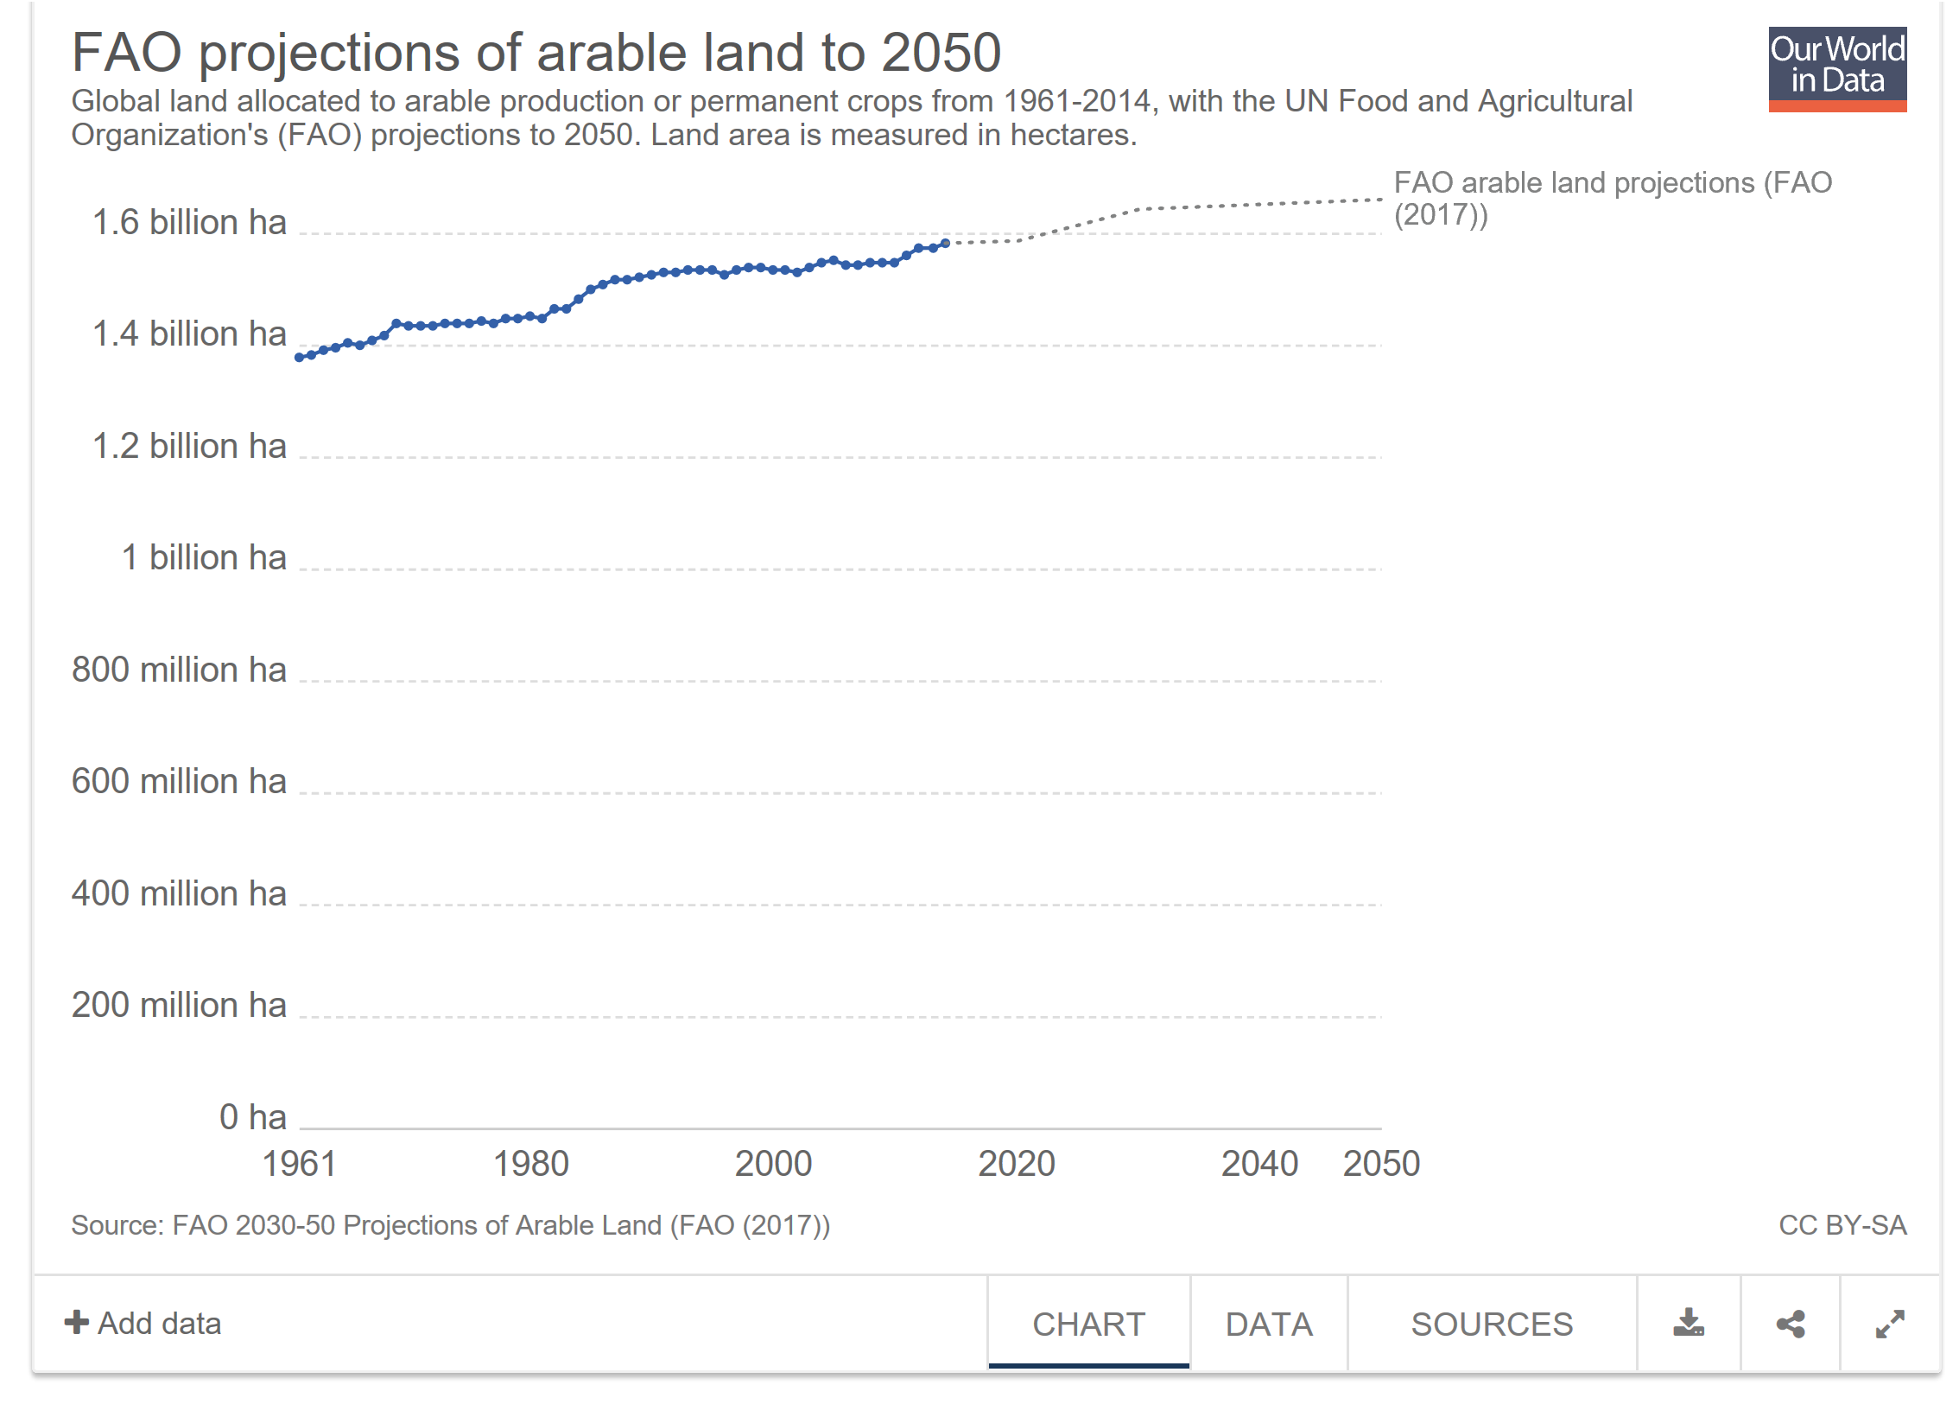
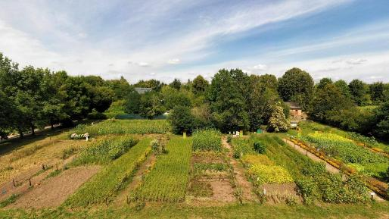
FAO global (planet-wide) projection of arable land until 2050 (ha).
1.600.000.000ha / 8.000.000.000 persons = 2000m² per person
One piece of land, about 45m long, 45m wide per person.
Global average.
www.2000m2.eu/de/
CC BY-NC-SA 3.0 DE
https://ourworldindata.org
12

Slide 13

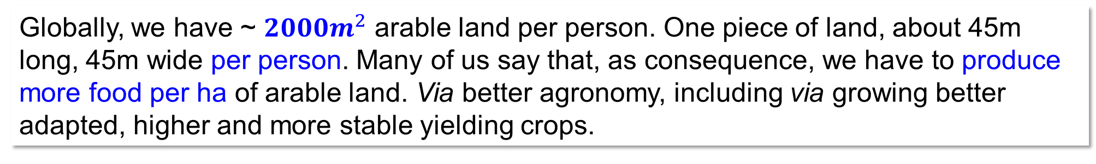
Feed one person from the productivity of 2000m² land, including strawberries for breakfast and millet to feed your parrot ;-).
Globally, we have ~ $2000m^{2}$ arable land per person. One piece of land, about 45m long, 45m wide per person. Many of us say that, as consequence, we have to produce more food per ha of arable land. Via better agronomy, including via growing better adapted, higher and more stable yielding crops.
13
www.2000m2.eu/de/
CC BY-NC-SA 3.0 DE

Slide 14
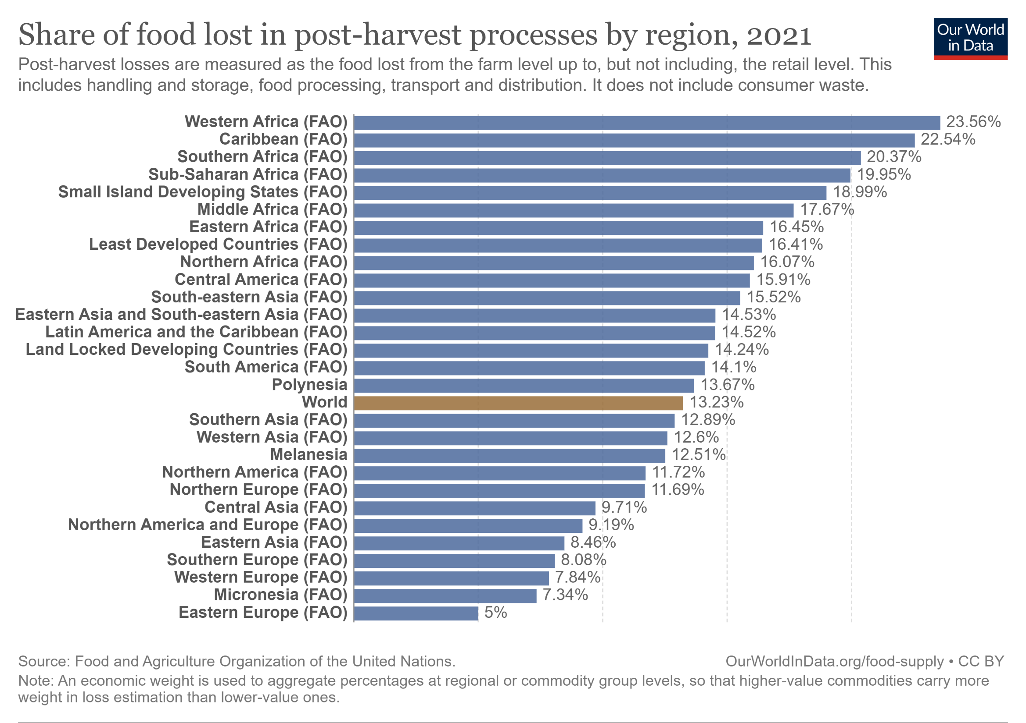
Not Plant Breeding yet important: Post-harvest losses. At farm, at handling, storage, processing, transport & distribution. Excluded is still consumer’s waste.
https://ourworldindata.org
First yield loss is due to lack of good seed, fertilizer, irrigation, loss by pests and diseases. Such yield gap was 6-7 t/ha for maize in 2021 in e.g. Morocco, Algeria, Libya.
It was as large as yield in Australia, where the yield gap was only 0.5 t/ha (Yield gap: differ-rence between yield and attainable yield using current, good technologies and management).
Nota bene: ‘Decrease loss’ is more sustainable than ‘Increase production’.
Higher-value food with higher weight in loss than lower-value food. OurWordinData.org/food-supply CC BY
14

Slide 15
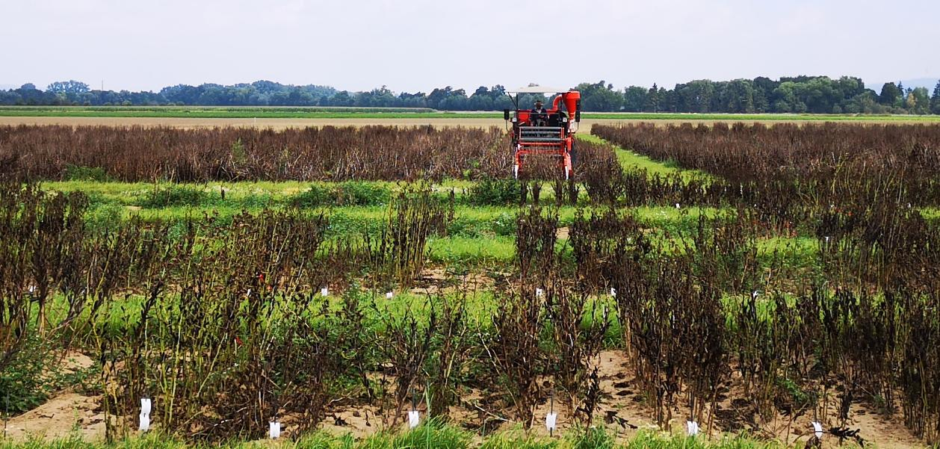
Plant Breeding is one of many approaches to lessen hunger and deal with further global and local problems. We need all available approaches, elements, tools.
15
© WL
15

Slide 16
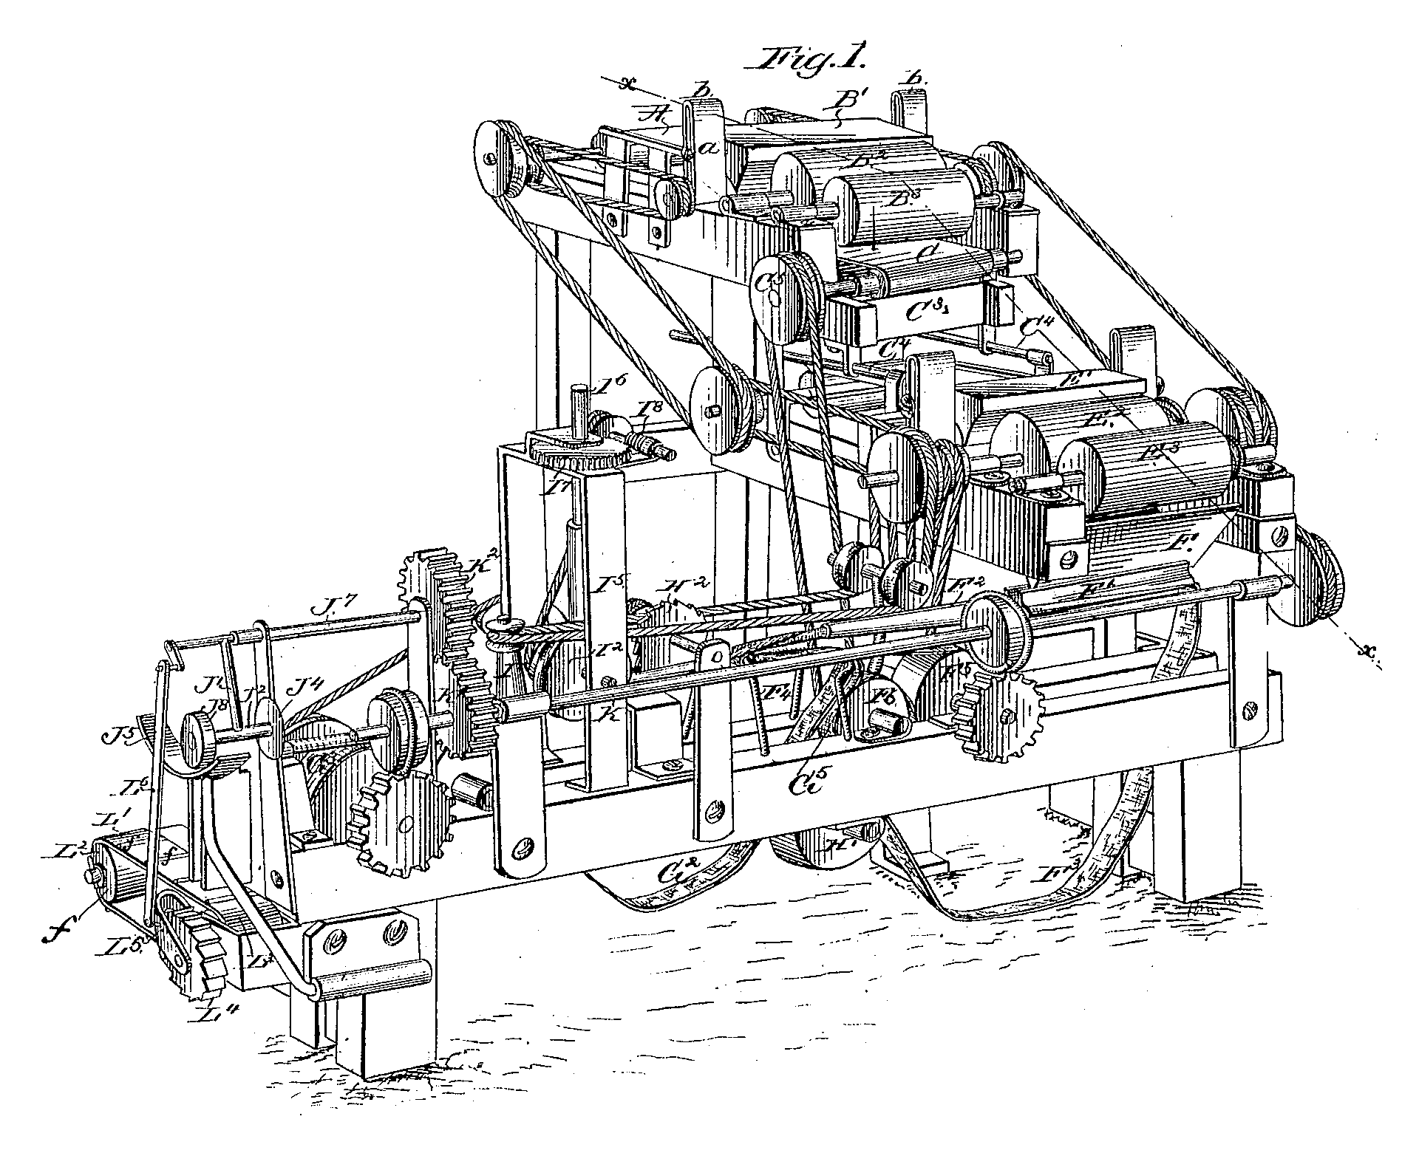
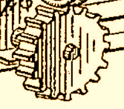
Developing plants which are better adapted to stressful climate is just one element out of many to improve ‘feeding the world’.
If such machine symbolizes the factors and forces that jointly produce and distribute ‚food-for-the-world‘, then of course plant breeding is just one piece of it.
Fair und good global nutrition of humankind is a standing problem and unsolved task. Levers and gears are many, all branches of Agronomy and Agriculture have to cooperate to jointly improve and stabilize farmers’ yields.
Problems others then the initial production (agriculture) are post-harvest loss, corruption, theft, sloppiness, greed, stupidity, war, et cetera.
Agronomists and plant breeders must be (1)
self-critical and humble yet (2) eager and hard-working, inventive and ambitious to really contribute to betterment and solution.
16
J.A. Bonsack (1859-1924) https://commons.wikimedia.org/w/index.php?curid=1267158. Machine.

Slide 17








Genetic improvement of domestic plants is in most societies accepted as a necessary task and functioning activity.
Philosophies on breeding as a craft and as a science are divided among stakeholders. For instance, some follow Rudolf Steiner (including occult and esoteric ideas). Main stream follows Gregor Mendel, Ronald A Fisher et al., i.e. the evidence-based, scientific approach.
Yet, in spite of such tremendous differences, they all know that plant cultivars from the ‚good old days‘ are less adapted to current pests, diseases, climate, agricultural processes than newly-bred cultivars. Hence, they all breed, select, and use seed of improved genotypes.
Breeding food crops is not a luxury that may be abandoned in bad times. On the contrary, precisely then we need breeding to improve agricultural production.
The copyright for images of books or logos and the like always belongs to the author or publisher or company, so please take strict note of this when handling them.
17

Slide 18

Fields in agronomy research which contribute to improve efficiency and sustainability of the production (my personal, subjective view).
Subject Area | Key terms | My personal comment ;-)
Agronomy | Rotations. Timing. Soil cultivation | Improved rotation increase sustainability
Agricultural Engineering | Machines. Precision farming | Improved machinery lower CO₂ footprints
Plant Nutrition | Fertilizer, N,P,K,S, others | Mineral N is energy-costly. P is depletion of limited global resources.
Phytopathology | Pests, diseases, antagonists, pesticides | Pesticides are energy-costly and poisonous.
Plant Breeding | Seed, genes, genetic improvement | Equipping seed with intelligence
Admittedly, my subjective view:
Plant Breeding is great, because breeders endow seeds with intelligence.
With this, plant become able to make MORE and BETTER from the SAME.
From the same time, the same light, the same soil, temperature, wind, air, CO₂ et cetera
Eventually even with less (irrigation, pesticide, ploughing etc.)
You can not do better to be organic, sustainable, resilient; can you?
18

Slide 19
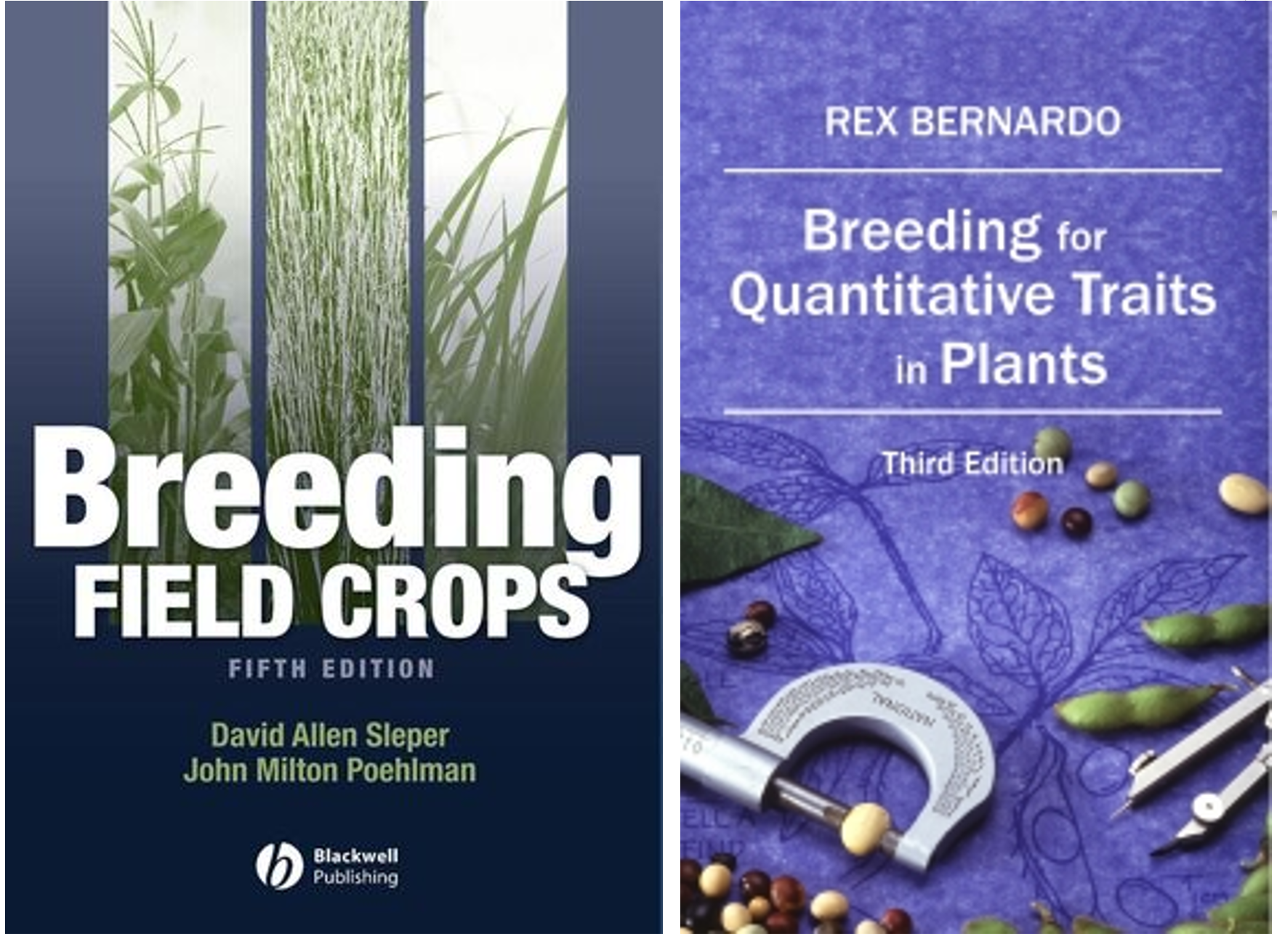
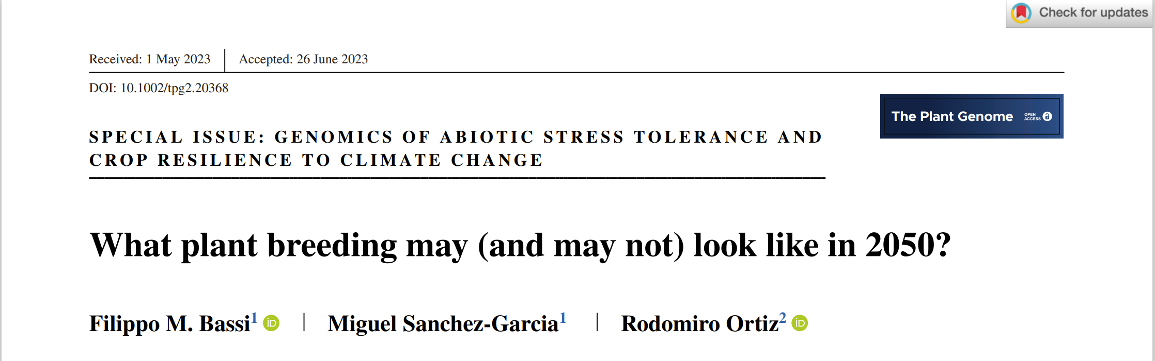
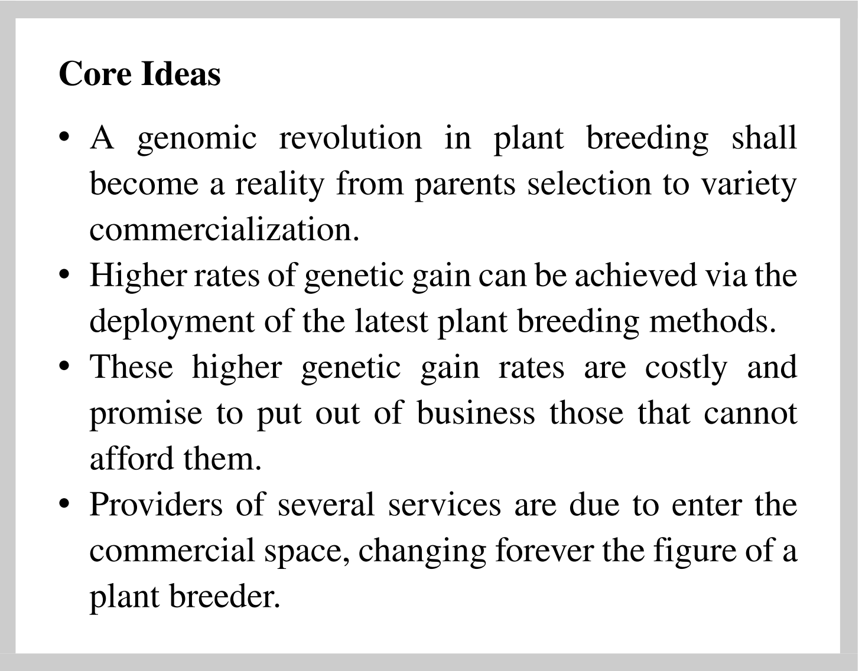
Plant Breeding as human activity was always based on experience, on try-and-error.
It is meanwhile based on science. On evidence. On the power of learning.
The copyright for images of books or logos and the like always belongs to the author or publisher or company, so please take strict note of this when handling them.
19

Slide 20
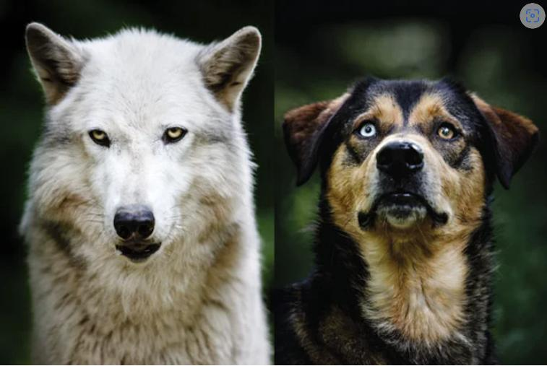

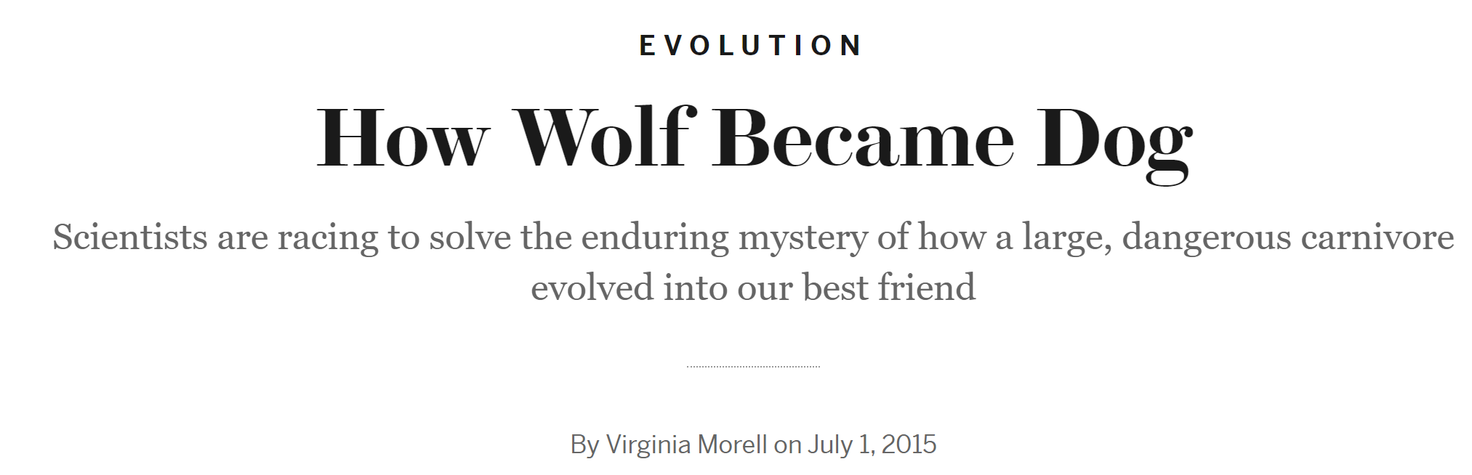
Evolution and Domestication are not myths but historical events.
They are ongoing processes; while the claims of Intelligent-Designers and hard-core Christians et al. about the origin of today's biodiversity are not based on evidence. In the same way the Germanic Norns (Skuld, Verdanda, Urd) who are sitting at the World Ash ‘Ygdrasil’ are not reports about the true world. Just like ‘Ents’, ‘Elves’, ‘Dwarves’, ‘Hobbits’ are not real. I would not call them for help in case of an accident. ISBN: 978-0-593-06173-2
Compare, for instance, size of eyes
Just like Evolution and Domestication, Breeding is only understandable if we follow the evidence-based approach. For this, we employ ‚Science as a Way of Knowing‘. ISBN 9780674794825
Here I would like to argue against superstition and esotericism gaining the upper hand in the work on crop improvement
20
www.scientificamerican.com/article/how-wolf-became-dog

Slide 21
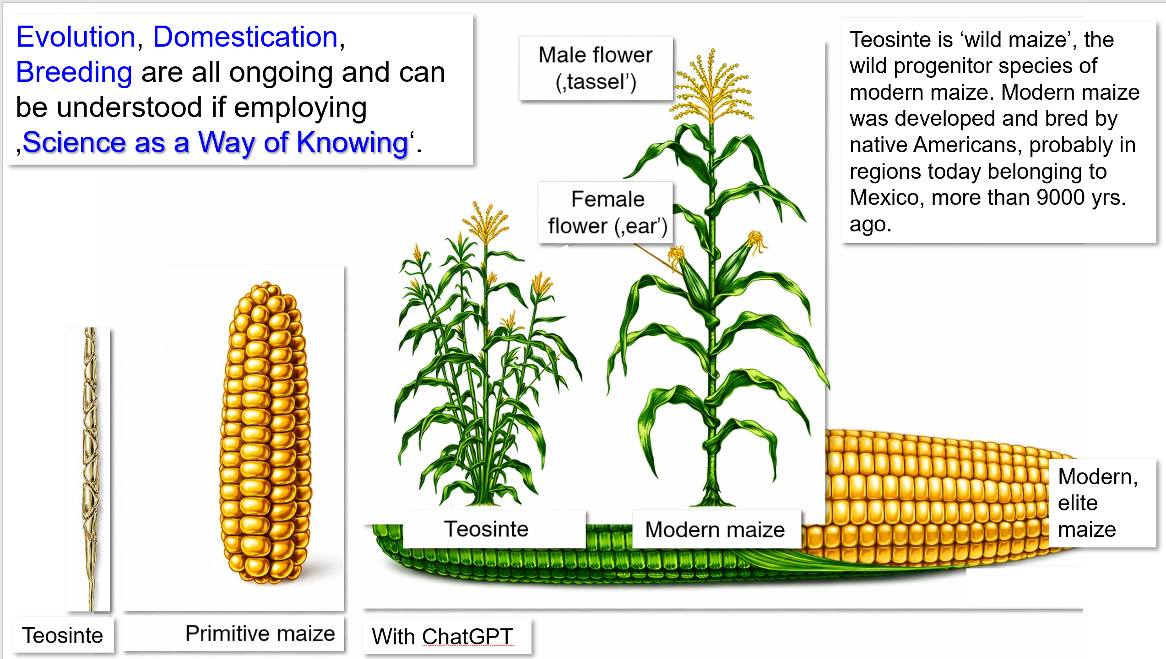
21

Slide 22
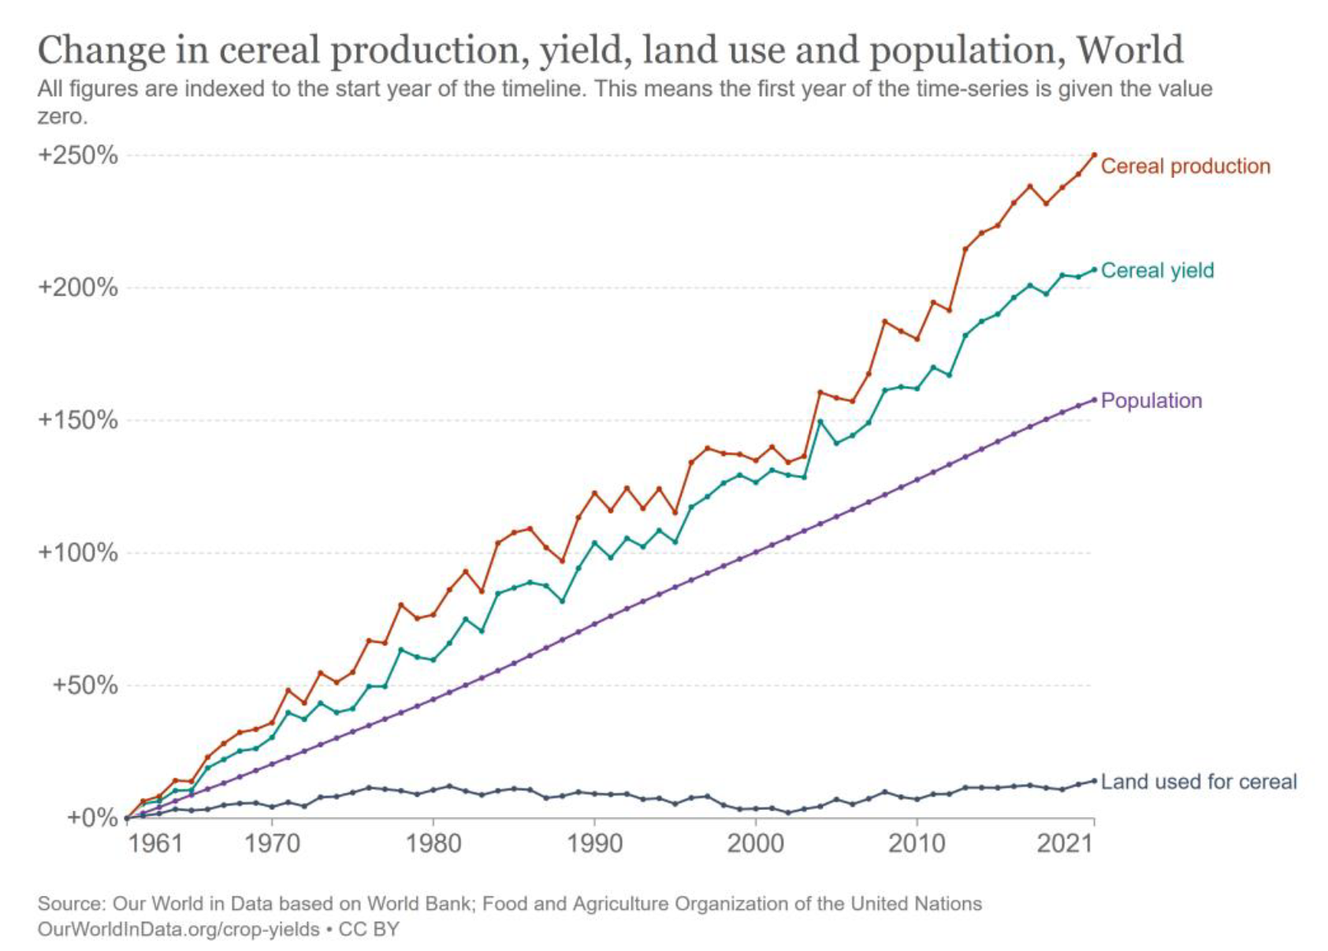
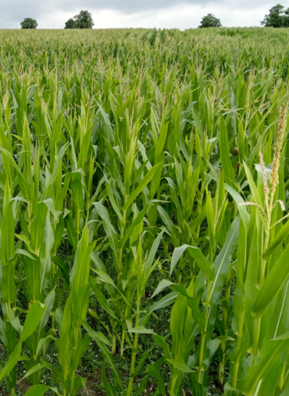
Yield and thus production of arable crops increased steadily. Agronomic improvements (including Breeding) were large. This contributed to prevent hunger for most of us in the last decades, in spite of population growth.
Change in global cereal production, relative to status of 1961.
How much longer can this possibly go on ?
Cereal production
Cereal yield
Population
Land used for cereal production
OurWorldinData.org/crop-yields CC BY
© wlink
22
https://ourworldindata.org

Slide 23
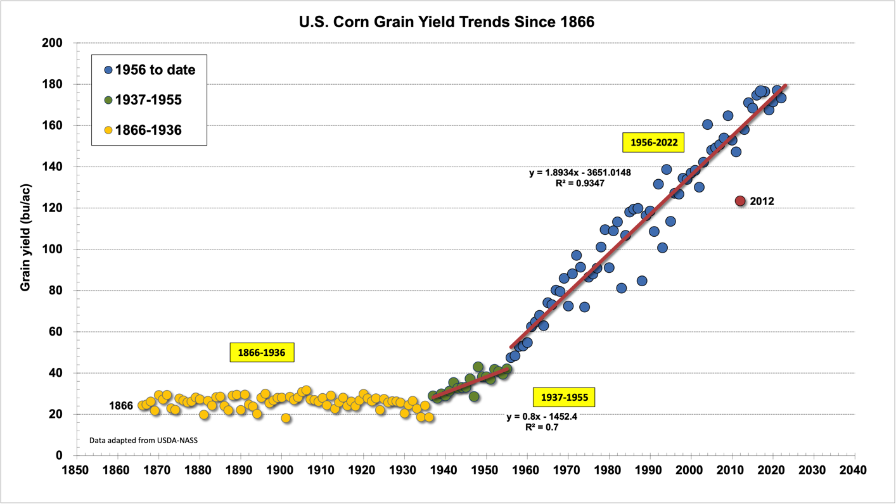
How much of ’Save the World’ may come from increasing agronomic yields per area? http://www.kingcorn.org/news/timeless/YieldTrends.html
USA Corn grain yield trends since 1866
1996-today: Single cross hybrids with GMO traits (herbicide & in-sect resistance)
Single cross hybrids
1956-2022
Slope = 1.89; R²=0.935
Very dry season: 2012
Population cvs.
1966-1936
Double cross hybrids
1937-1955
https://ourworldindata.org
23

Slide 24
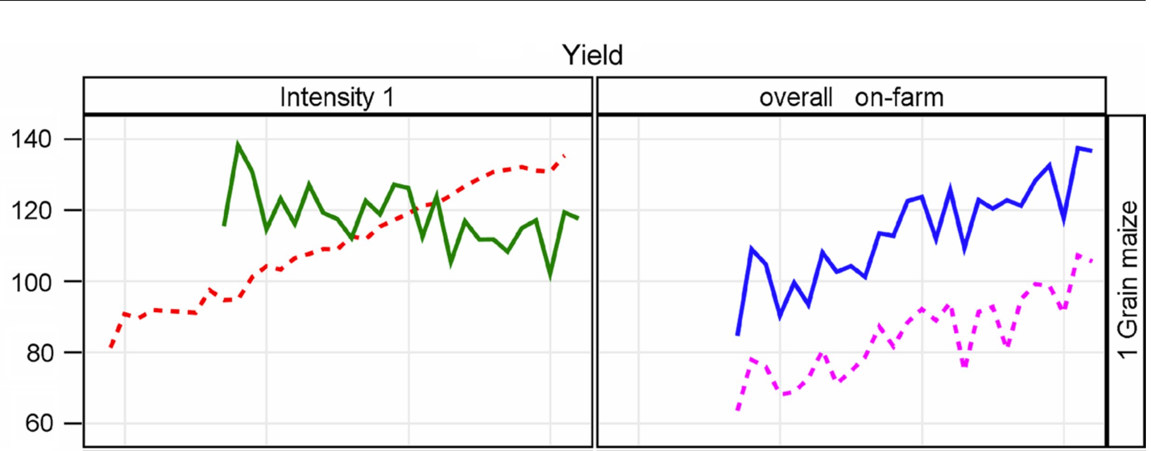
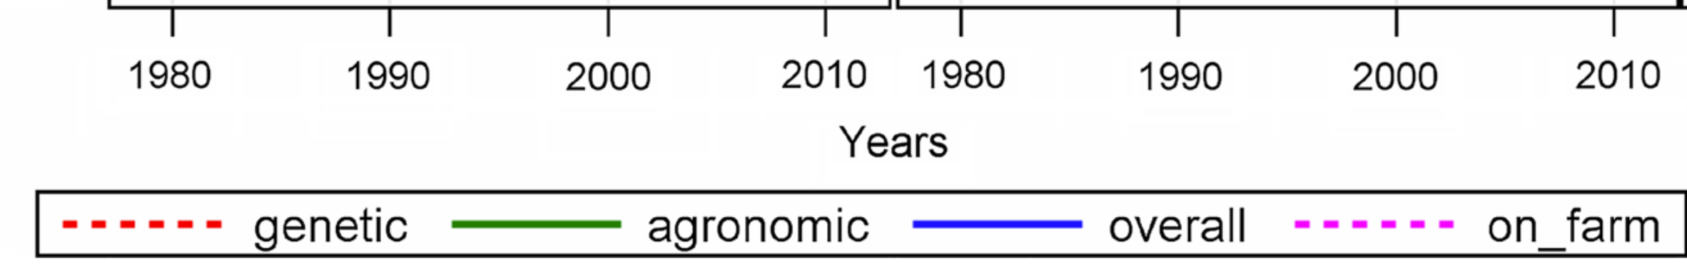
Adjusted yield (dt/ha) of grain maize (‚best’ local agronomic practice yet no fungicides). Genetic: Gain from breeding. Agronomic: Impact of season. Overall: Trial data.
On-farm: National data from farms. DOI 10.1007/s00122-014-2402-z
Grain Maize
24

Slide 25
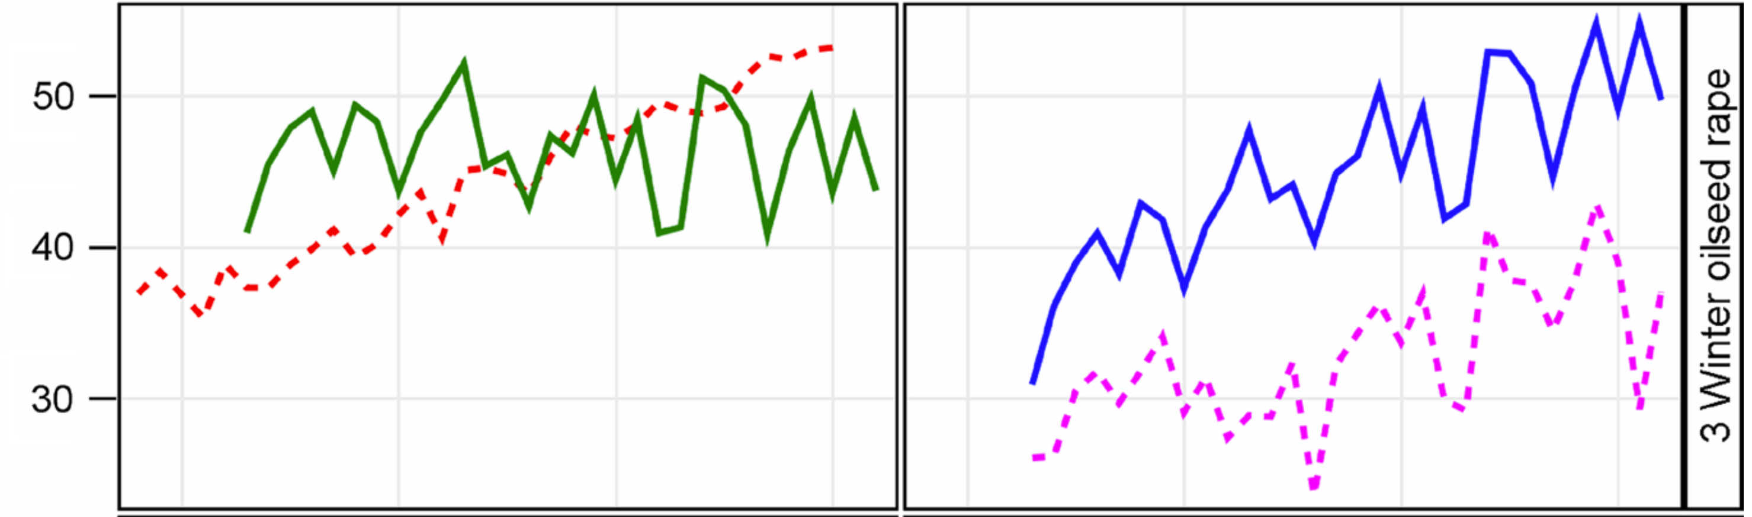
Adjusted yield (dt/ha) of winter canola (‚best’ local agronomic practice yet no fungicides). Genetic: Gain from breeding. Agronomic: Impact of season. Overall: Trial data.
On-farm: National data from farms. DOI 10.1007/s00122-014-2402-z
Winter canola
25

Slide 26
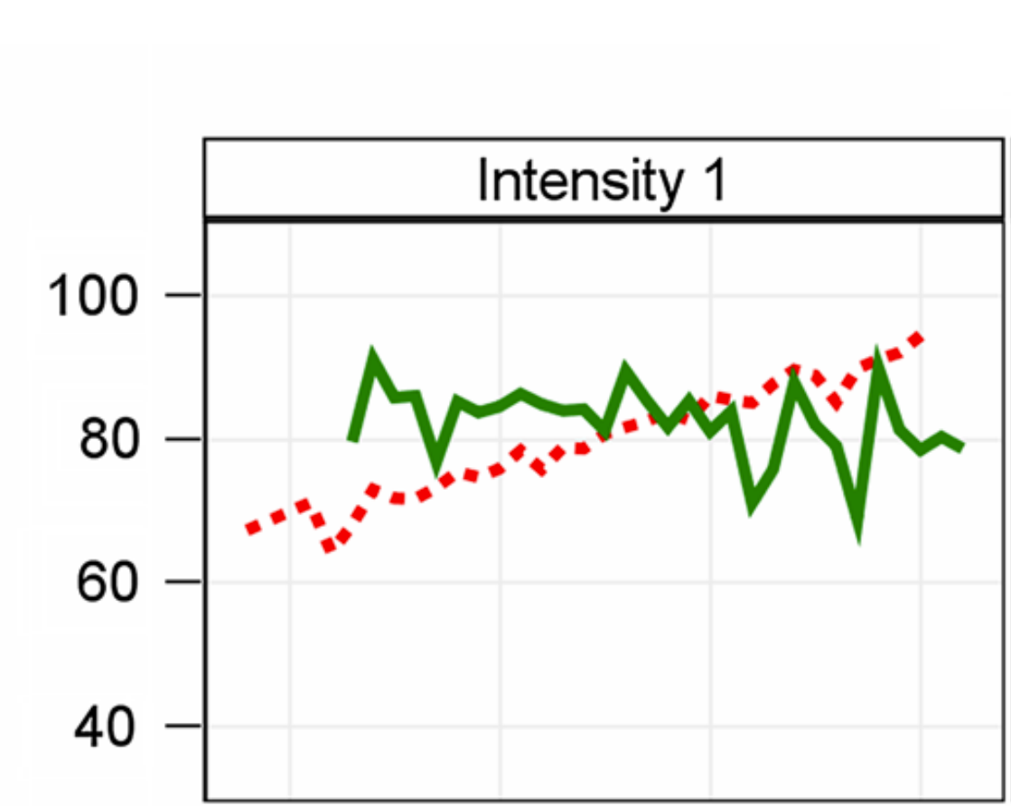
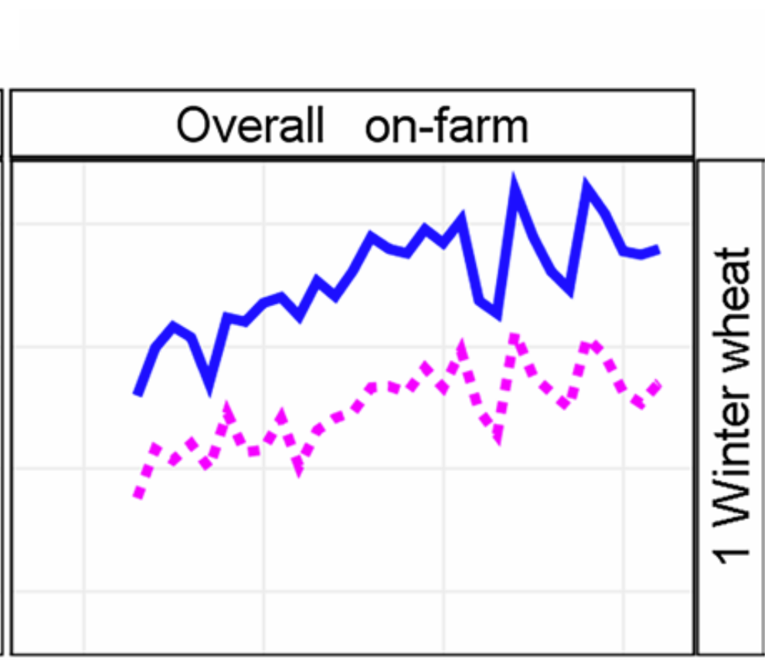
Adjusted yield (dt/ha) of winter wheat (‚best’ local agronomic practice yet no fungicides). Genetic: Gain from breeding. Agronomic: Impact of season. Overall: Trial data.
On-farm: National data from farms. DOI 10.1007/s00122-014-2402-z
Winter
Wheat
26

Slide 27
A significant, very marked share of yield increase in Agronomy in the past decades can be attributed to the genetic improvement of the crops. DOI 10.1007/s00122-014-2402-z
It is not trivial to conduct a fair comparison between cultivars bred long ago and cultivars bred recently.
Of course we can compare old and new cultivars, and even adjust fertilizer and chemical protection of crop stands to what was ‘normal’ in the past and what is ‘normal’ today.
Still, such comparison is incomplete, unfair, because the old cultivars were not bred for the current environments. Not for the increased CO₂ levels, not for the modern types of viruses and fungi and the modern types of insect pests. Not for the modern field machines.
To have a full and fair comparison, we should compare the old and new cultivars today and in addition in the old times’ environments. Well.
This is – of course – impossible.
Nevertheless, there are statistical approaches to convin-cingly separate the genetic impact from the environmental and GxE impact on crop performances.
Grain Maize
27

Slide 28
A significant, very marked share of yield increase in Agronomy in the past decades can be attributed to the genetic improvement of the crops. DOI 10.1007/s00122-014-2402-z
Grain Maize
There are statistical approaches to separate the genetic impact from the environmental and GxE impact on crop performances when comparing old, outdated cultivars with current cultivars.
Such analyses show the genetic impact on today yields.
Again: Such analyses show that a marked share of the current-day yield from arable crops must be attributed to success in crop breeding, so-called ‘Gain from Selection’.
28

Slide 29
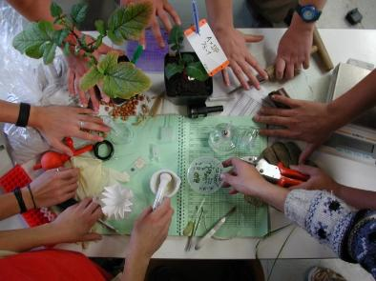
There is no (Plant) Breeding without selection. And none without cooperation.
Between breeders, seed producers, farmers, consumers.
Farmers have the right to sow grains harvested as yield from their field – even if that field was sown with seed of a released elite cultivars. But: There are harsh restriction on this, mainly to keep ‘seed rotation’ high (farmers buy certified seed instead of re-using farmers-saved seed); typically seed price includes royalties for the breeder – a way to re-finance breeders’ work.
Breeders have the right to use any released cultivar to make a new cross: With restriction, especially if such cultivar contains patented genes.
core.ac.uk/download/pdf/188776454.pdf; european-seed.com/2017/04/closer-look-interrelation-farmers-rights-breeders-rights; www.z-saatgut.de
© WL
Understand the difference between Plant Breeding in general (e.g. including Pre-Breeding) and Plant Breeding in narrow sense, which is the actual development of new cultivars.
Understand the difference between Plant Breeding and seed production. Typically, seed production (and production of tubers and bulbs and cuttings et cetera) is conducted by specialised farmers. Exceptions are if seed is very small (volumes sown per ha are little): Canola breeders typically produce seed-for-farmers in-house.
Understand the difference between sowing and planting. Whatever sloppy use of terms you hear or read: corn is sown, not planted. Sugar cane is planted, not sown. By the way: See a difference between sowing and seeding. To seed means seed the field, the area. To sow means to disperse and distribute seed. You seed the field, you sow the plant seeds.
29

Slide 30
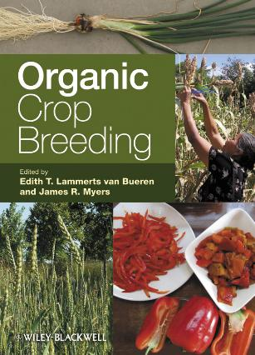
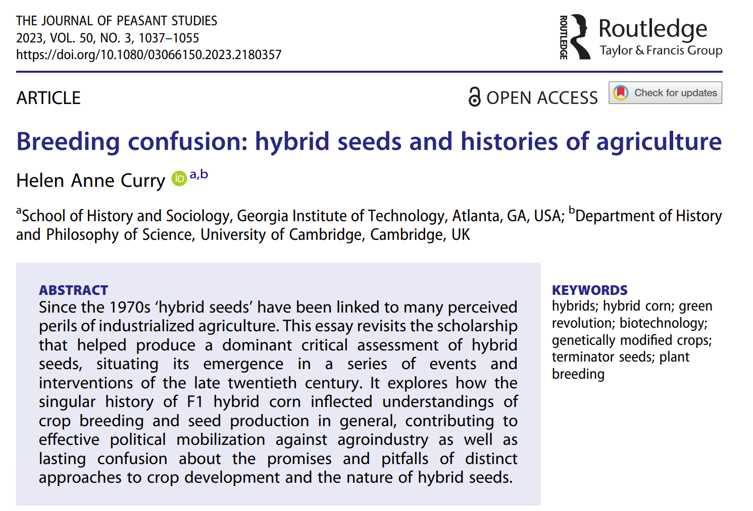
Plant Breeders are people with diverse world views, philosophies.
In Plant Breeding too, there are fake news and rural myths. Example:
If hybrid cultivars (e.g. tomato, corn, sunflower) are harvested and seed was used again as farmer’s saved seed, then such seed is neither dead nor will e.g. corn mutate into a weedy plant. Yet, the resulting crop stand will become somewhat heterogeneous and, in case of outcrossing species, the crop will yield less, may be 10% - 50% compared to the initial hybrid cv.
In Germany, re-use of seed from hybrid and synthetic cvs. is – anyway – illegal. By the way: The Monsanto-idea of ‘terminator seed’ was never realized.
Organic Breeding brings many new ideas, concepts and restrictions. Understand the difference between breeding for organic conditions and breeding in-and-for organic conditions.
Organic Plant breeding research and variety testing, www.fibl.org/en/themes/plant-breeding.
www.lobbyfacts.eu/datacard/european-consortium-for-organic-plant-breeding?rid=329523333979-86.
geneticliteracyproject.org/2023/05/16/cracks-appear-in-europes-opposition-to-crispr-gene-editing-and-other-new-breeding-technologies.
30

Slide 31
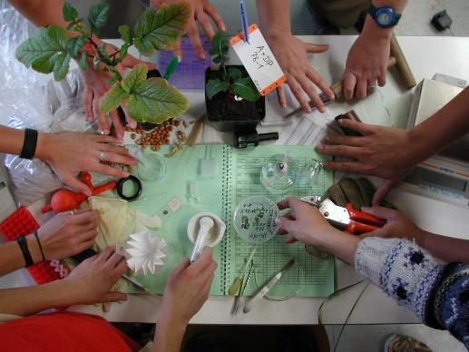
There is no (Plant) Breeding without selection. And none without cooperation.
Between individuals, between institutions, regions, nations, international alliances.
Some pertinent stakeholders
● Consultative Group on International Agricultural Research;
www.cgiar.org
● International Center for Agricultural Research in the Dry Areas
(ICARDA), www.icarda.org
● Max-Planck-Institute for Plant Breeding Research,
www.mpipz.mpg.de
● Federal Plant Variety Office, www.bundessortenamt.de/bsa/en
● Bundesverband Deutscher Pflanzenzüchter e.V., www.bdp-
online.de
● Federal Plant Variety Office, www.bundessortenamt.de
● Institute for Breeding Research on Agricultural Crops, www.julius-
kuehn.de
Plant Breeding and seed production is an important business.
In the EU, in 2012, the value of the seed market reached around 7000 million €
There are around 7000 seed companies in the EU. Most of them are ‘Small and Medium’ sized companies. There are about 2000 breeding companies and Poland and in Romania, for instance; and between 120 and 350 in France, Italy, Germany, Netherlands, Slovakia (https://www.europarl.europa.eu/RegData/etudes/note/join/2013/513994/IPOL-AGRI_NT(2013)513994_EN.pdf).
31

Slide 32

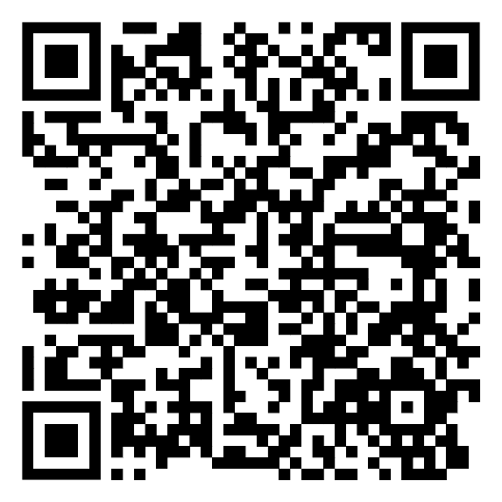
Plant Breeders integrate ‘breeders’ eye & intuition with science and new techniques. They often try their luck with some additional, unusual crosses. Cultivar-making takes many years: Breeders have to anticipate today the needs of after-tomorrow.
Plant Breeding is an applied science. Breeders apply genetics to develop genotypes (cultivars) which perform better in agriculture (horticulture, silviculture, viticulture) than existing cultivars. Breeding objectives reflect human needs and desires (not the survival criteria in the wild).
Plant Breeders apply Botany, Agronomy, Genetics (Classical, Molecular, Quantitative), Genomics, Pathology, Statistics, and more. Plant Breeding in narrow sense: Development of improved cultivars. In broad sense: All pre-breeding and breeding research activities contributing to genetic crop improvement.
Nota bene: Plant Breeding is not the same as production of Certified Seed (of released cultivars); although this is the materialized product of breeders.
Plant Breeders work in office to plan the season, analyse results, visit lab, workshop, workroom to plan and discuss there, drive from location to location to visit their field nurseries, walk through field nurseries to take series of visual scores, fly drones there, visit congresses to give and listen to talks. They create novelties, new types of plants.
32

Slide 33
From here you may go to UNBLAB-PopGen_Ch-1[HWE I]
33

